Slide 1
ODIN - Operational Data Integration Nexus
Joon and Junda

Slide 2
Overview:
Setting up the database
Customer Relationship Management
Statistics and information

Slide 3
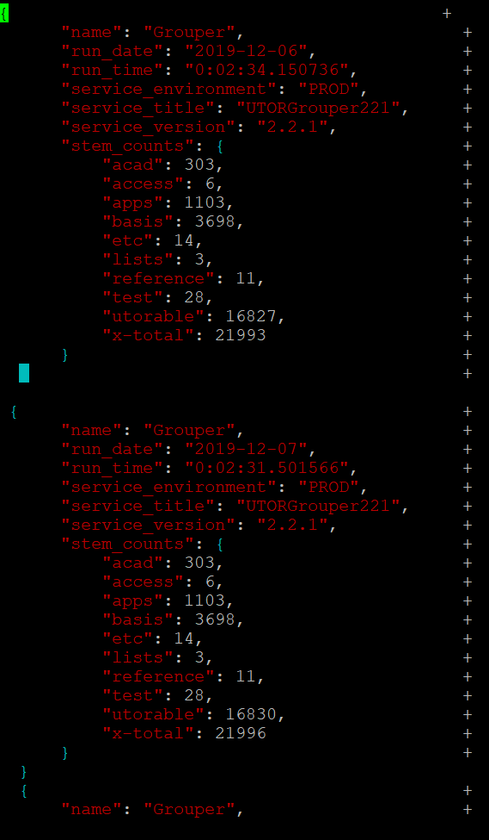
Collecting Statistical Summary: Grouper
A sample JSON Blob produced in the Grouper database with various information contained inside them.
The file shown on the left, test.json, contains around 100 recordings each.

Slide 4
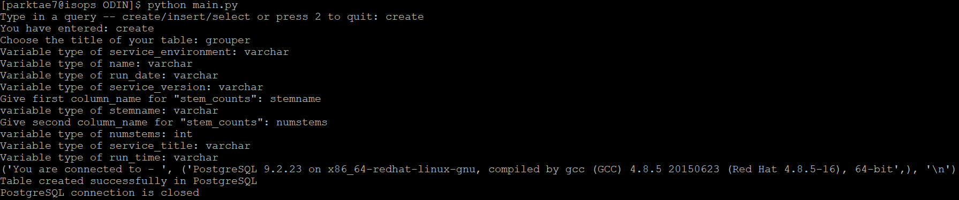
Our API - create

Slide 5
Create Query - Intuition
In order to create a table in our database, we first call in the json blob and create a table based on the keys in the dictionary of the json objects.
Before doing this: we converted json objects into a list of dictionary for efficiency in parsing through the JSON objects
Limitations
We manually input the data type (maybe automate this? What is the cost that follows along with this?)
If there is a nested dictionary as shown in the example before, we need to manually state the name.
Currently, we hard-coded stemname and numstems into our insert statement. Therefore, when creating a table need to have ‘stemname’ and ‘numstems’ be stated explicitly.
If we have more information on how other databases collect their statistical summary, we will make this more scalable.

Slide 6
Our API - insert

Slide 7
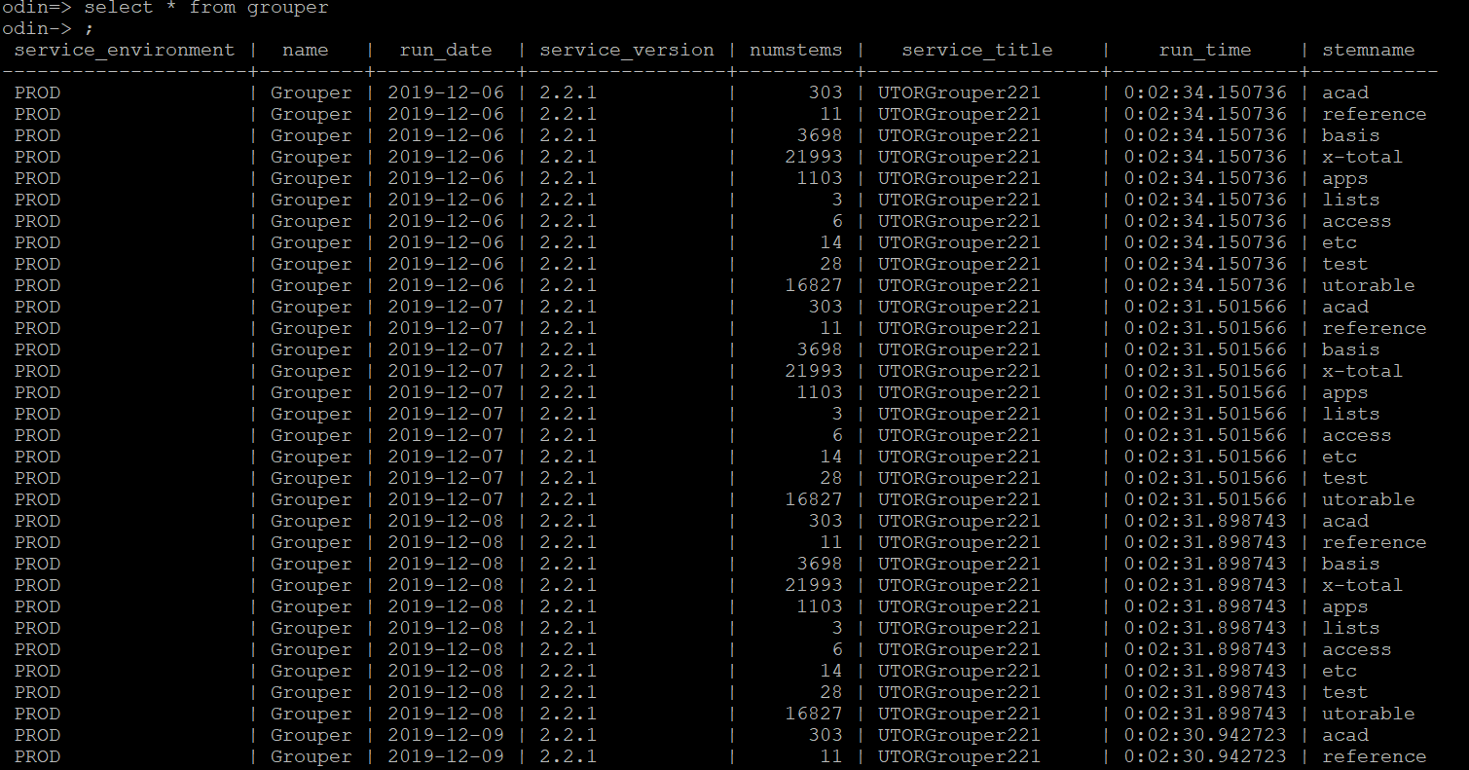

Slide 8
Insert Query - Intuition
The insert query is generated by taking in an array of dictionaries. It then creates a massive insert query based on this.
An example of an insert query will be shown in the next page.
Limitations
Might cause duplicates when insert entries separately

Slide 9
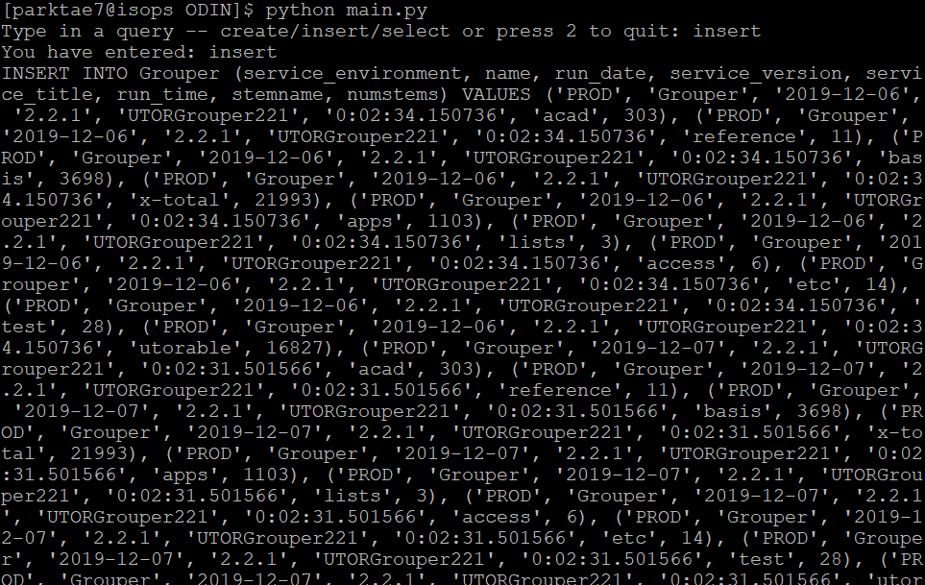

Slide 10
Overview:
Setting up the database
Customer Relationship Management
Statistics and information

Slide 11
2) Customer Relationship Management
SP/Certificate/LDAP/Grouper : maintain information about each service provider, the people associated with them (accountability), certificate status for the SP, the LDAP service account associated with it, the Grouper areas associated with it, and the history of activities (create, change, etc)
In order to fulfill these requirements, we are trying to look into Corteza and see how this works and how we can implement the functions inside our database.

Slide 12
Corteza vs our own API
Considering time, scalability, and practicality … We decided to implement our own API.
Functions include:
Getting a list of SP
For any given SP, who is the responsible person?
What other info for that SP can be shown?

Slide 13
Service provider database functions
Provide an easy and user-friendly way of lookup data in Shibboleth(SP) database
Provide summary on SP data
Ex.
Generate a comprehensive list of all the SP and each of their attributes
Track SP admin
Find the most up to date -- total count of SP

Slide 14
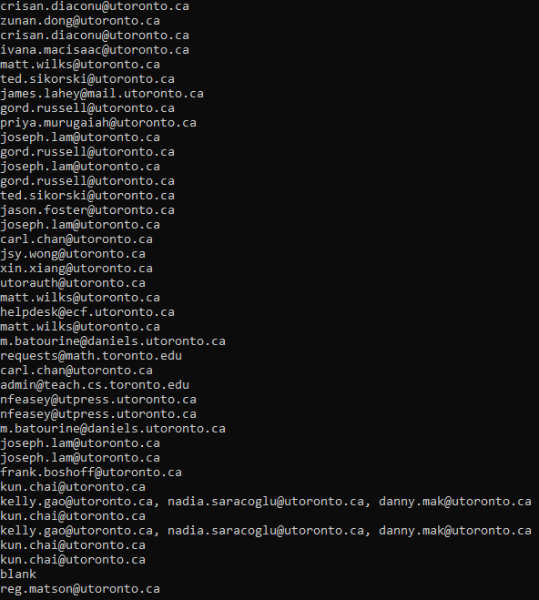
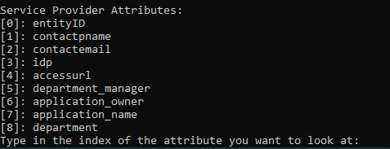
Lookup Service Providers
We are able to look at the entire set of each of the properties in the dataset.
We are able to look up the count of service providers.

Slide 15
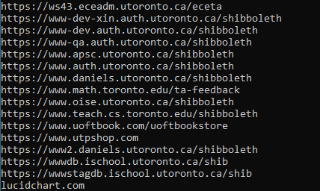
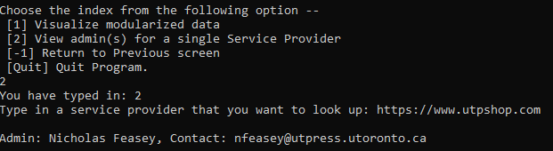
Look up Individual Service Providers
For a single SP, we are able to show who is the admin and their contact information

Slide 16
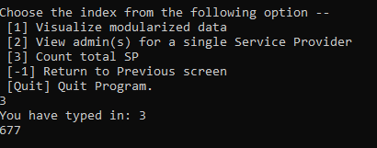
Look up total SP count
We are also able to visualize the total count of service providers and are able to visualize this as data comes in

Slide 17
3) Statistics
Intent:
collect statistical and summary info from the various IS services managed by the Service Delivery Group; present this info in tabular and graphical means that can be used by any member of the service delivery team.

Slide 18
Etoken database functions
Provide an easy and user-friendly way of lookup data in Etoken database
Provide summary on etoken data
Ex.
Number of users using etoken
Number of users using virtual etoken
Provide information about specific etoken user

Slide 19
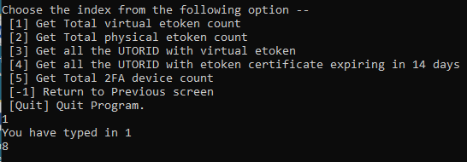
Number of users using virtual etoken
We are also able to look at the number of users using virtual etoken
Note: Need the original database to be up to date for this function to work up to date

Slide 20
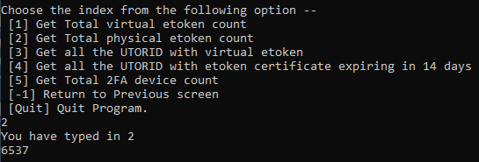
Number of total users using normal etoken
We are able to also visualize the total number of normal etoken count
Note:
Once the MFA is implemented, we plan to get the total MFA user count by adding the normal and the virtual etoken count -- add this into DUO

Slide 21
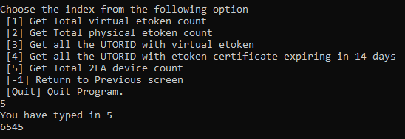
Total number of etoken users
We are able to get the Total etoken count
This will be useful when the MFA product is deployed

Slide 22
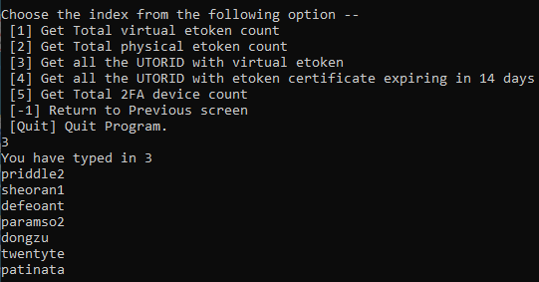
Link the users with the virtual etoken
We are able to identify UTORID users who are using the virtual etokens

Slide 23
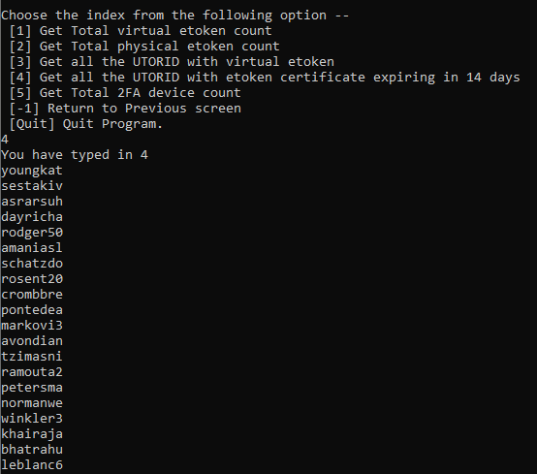
Generate a list of users with expiring cert.
We are able to visualize all the users who have expiring certificate in the next 14 days
Note:
Add these users into a grouper group and send them a notification that their certificate is expiring. Since we have the self service app developed, give them a link to this.

Slide 24
Oct 2019
Created our own ODIN requirements
Jan 2020 - Feb 2020
Understand Corteza or look for alternatives
Mar 2020 - April 2020
Get data summaries for SP & etoken
ODIN Timeline
Sept 2019
Researched and learned about various IT services
Nov 2019 - Jan 2020
Created an API for ODIN database
Feb 2020 - Feb. 29, 2020
Implement Customer Relationship Management
April 2020 - May 2020
Revised API for Processing data flow for Grouper

Slide 25
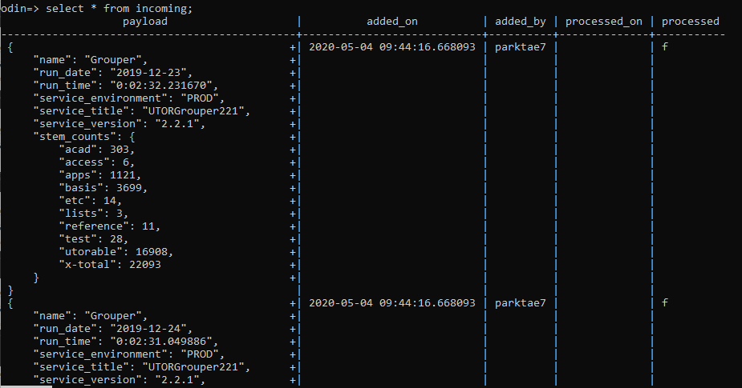
Grouper API
We receive data in the form of json blobs inside the incoming table of the ODIN database
Our goal is to process these files into corresponding tables depending on the name of the json blobs inside payload

Slide 26
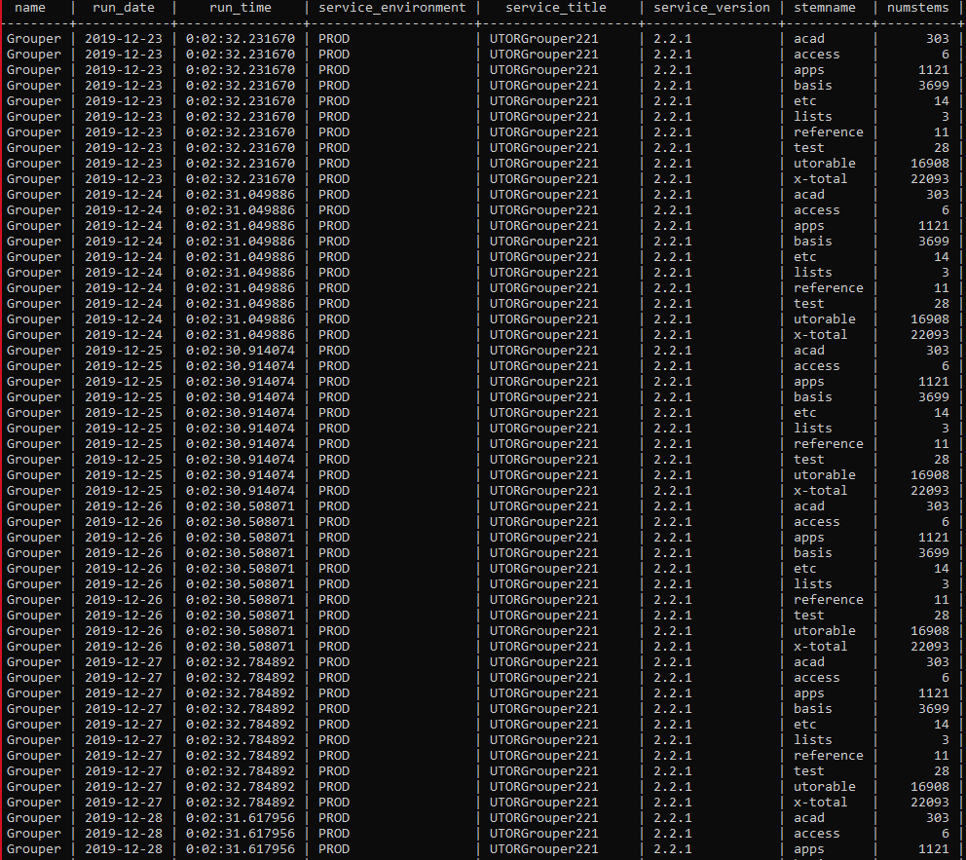
Processing json blobs
The json blobs are parsed and our API creates a Grouper table and sorts all the relevant information into a more modularized view
Our intent is to use this parsed information and use specific queries to create a more comprehensive view using Tableau

Slide 27
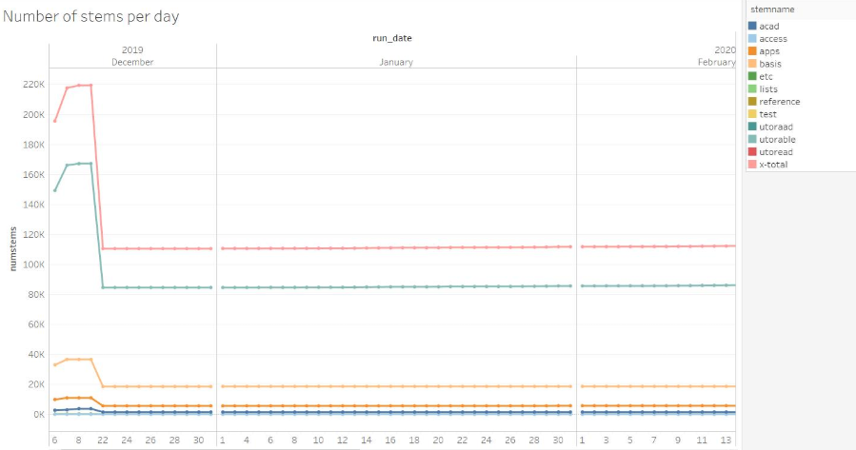
Tableau - Data Representation

Slide 28
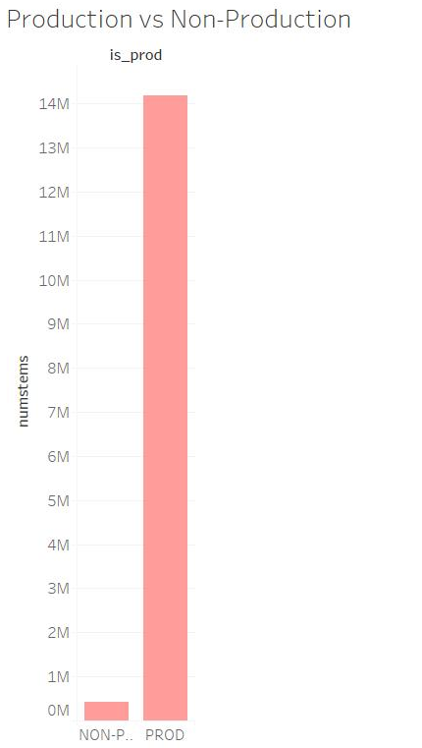
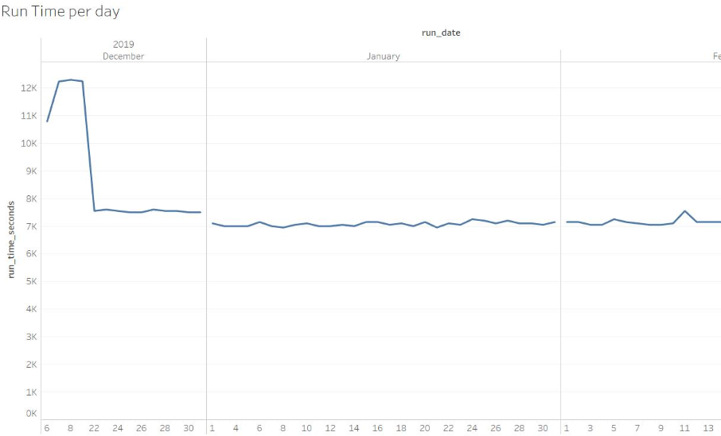
Tableau - Data Representation

Slide 29

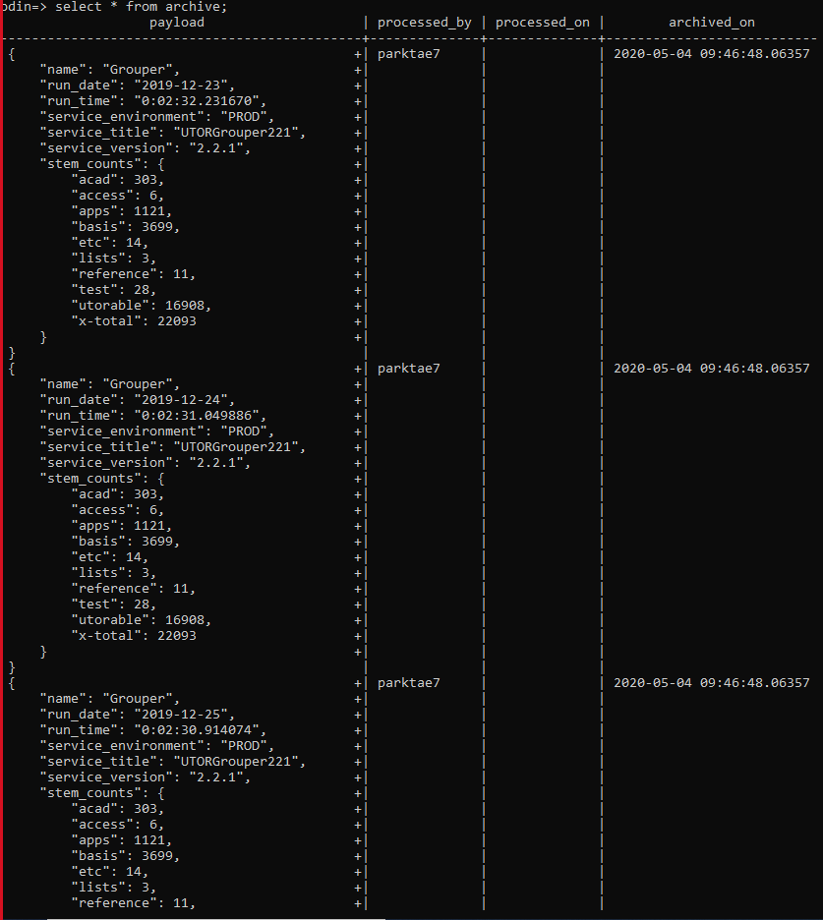
Trigger and reconstruction of incoming table
incoming
To assure data delete and write operation will be both atomic operation, we have implemented trigger for this operation
Our script also allow direct reconstruction of original incoming table from archive
archive

Slide 30
Future Steps...
We plan to create a front end section
Will include a GUI and dashboard
Implement statistics for Grouper database
Create a graphical representation in Zabbix -- tactical view of advising the health of the services
Create a graphical summary of the statistics for easier consumption of data
Catch for unexpected and expected exceptions in inputs, both manually and automatically

